Slide 1
Quality of Wine
By Anthony Lupo

Slide 2
Data Set of Vinho Verde Wines
Mixture of Red and White samples
Original Quality output was sensory data
1600 Different Wines in Data Set
Due to privacy and logistic issues, only physicochemical (inputs) and sensory (the output) variables are available (e.g. there is no data about grape types, wine brand, wine selling price, etc.).

Slide 3
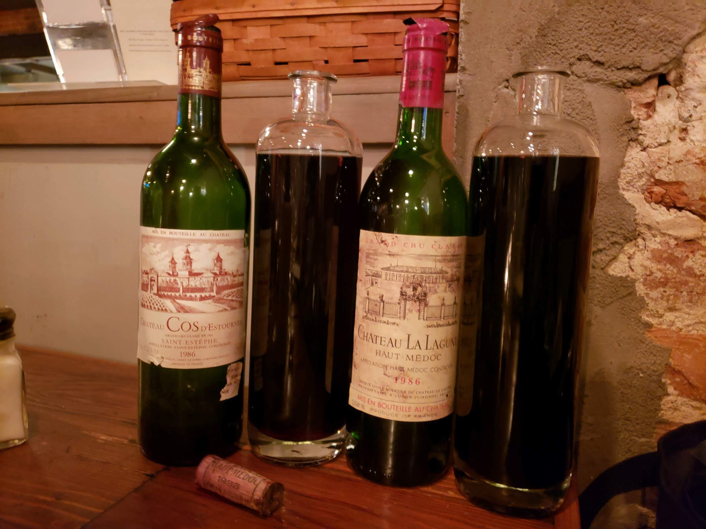
What is good Wine?
Sommeliers can tell the quality of the wine from sensory inputs, but what if you are making wine and don’t have a sommelier?
Can we use the physicochemical properties formed to predict it?
-Features:
-Input variables (based on physicochemical tests): 1 - fixed acidity (tartaric acid - g / dm^3) 2 - volatile acidity (acetic acid - g / dm^3) 3 - citric acid (g / dm^3) 4 - residual sugar (g / dm^3) 5 - chlorides (sodium chloride - g / dm^3 6 - free sulfur dioxide (mg / dm^3) 7 - total sulfur dioxide (mg / dm^3) 8 - density (g / cm^3) 9 - pH 10 - sulphates (potassium sulphate - g / dm3) 11 - alcohol (% by volume) Output variable (based on sensory data): 12 - quality (score between 0 and 10)

Slide 4

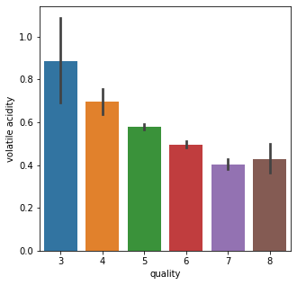


What did we find?
High Volatile Acidity is BAD!
Why?
Vinegar, “turned” taste

Slide 5
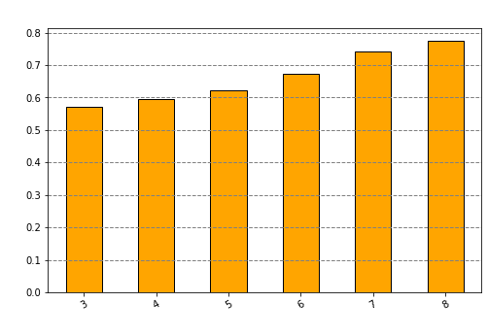
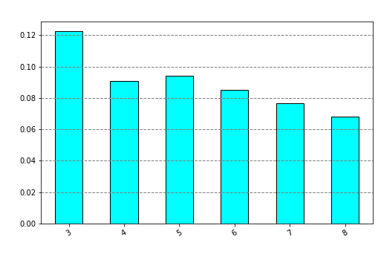
More Features that Effect Quality
Sulphates
Chlorides

Slide 6
Machine Learning Models
Prediction of Quality of Wine: Regression
Multiple Models:
RandomForest Regressor, KNeighbors, LGBoost, XGBoost
LGBoost, RF Performed the Best:
Accurate within ~.46 of a rating with no overfitting.
Light Gradient Boost Model is the model I chose.

Slide 7

Why Boosting?
Light Boosting Grading is a fast higher performance model that increases efficiency of models such as the Decision tree.
Reduces Cost for Calculating gain
Prone to overfitting
Corrected with Hyper-parameters

Slide 8
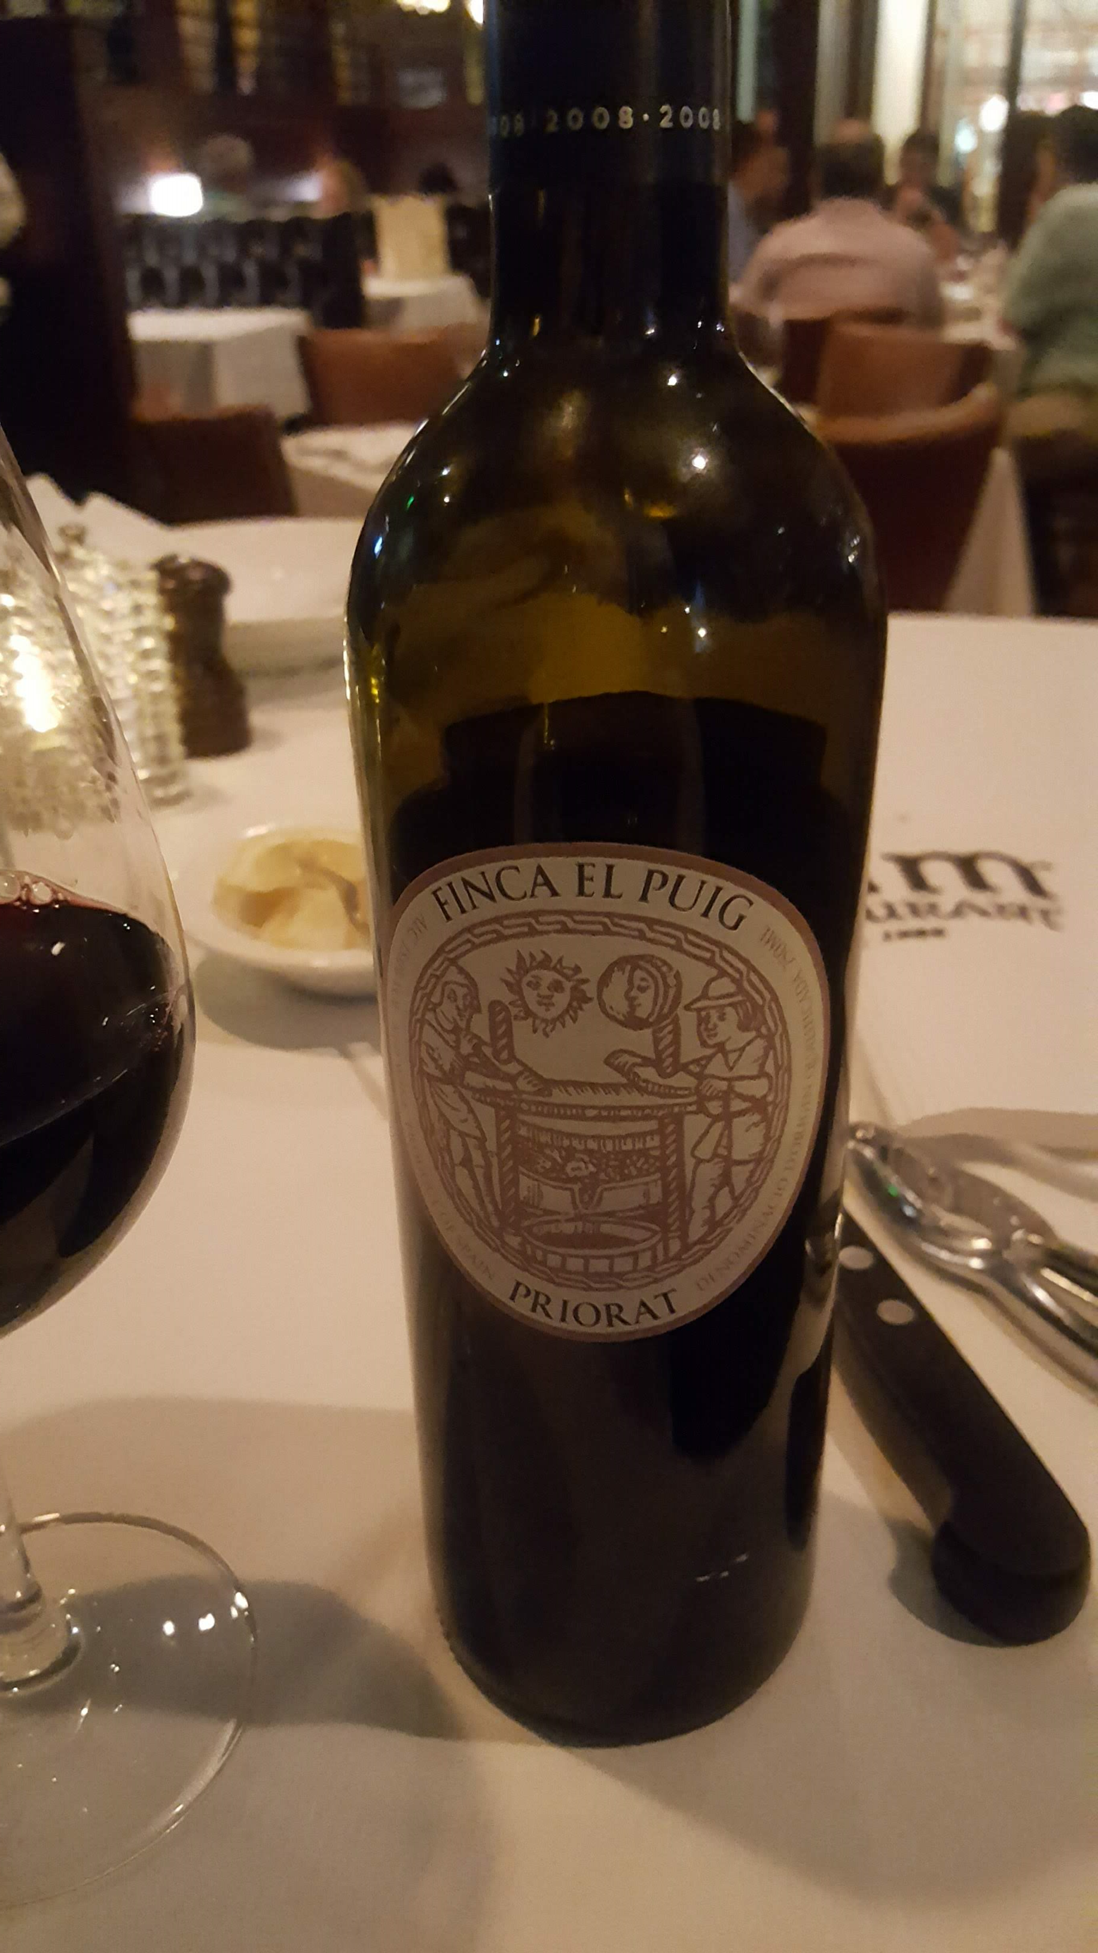
Recommendations
Use Blends of Grapes that:
Increase Sulphates
Decrease Chlorides
Decrease Volatile Acidity

